Slide 1
Probability
Venn diagram & Tree diagram

Slide 2
Starter
I flip two fair coins.
What is the probability that I flip 2 heads?
P(2 heads) =
What is the probability that I flip 1 head and 1 tails?
P(1 head and 1 tails) =
You can draw a diagram or table if it will help you.

Slide 3
Starter
I flip two fair coins.
What is the probability that I flip 2 heads?
P(2 heads) =
What is the probability that I flip 1 head and 1 tails?
P(1 head and 1 tails) =
Coin 1
H
T
H
Coin 2
T
TT

Slide 4
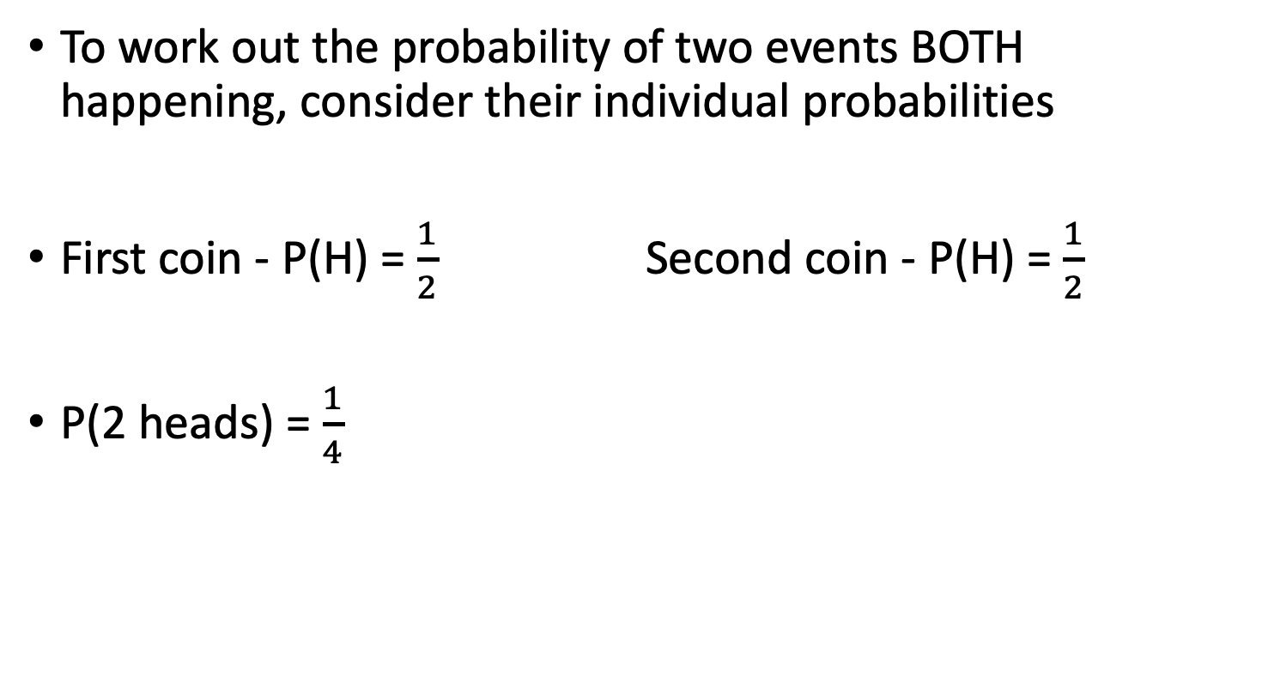
The ‘AND’ Rule
To work out the probability of two events BOTH happening, consider their individual probabilities
First coin - P(H) = $\frac{1}{2}$ Second coin - P(H) = $\frac{1}{2}$
P(2 heads) = $\frac{1}{4}$
Can you spot the link???

Slide 5
The ‘AND’ Rule
The Probability of events A AND B happening:
P(A and B) = P(A) x P(B)

Slide 6
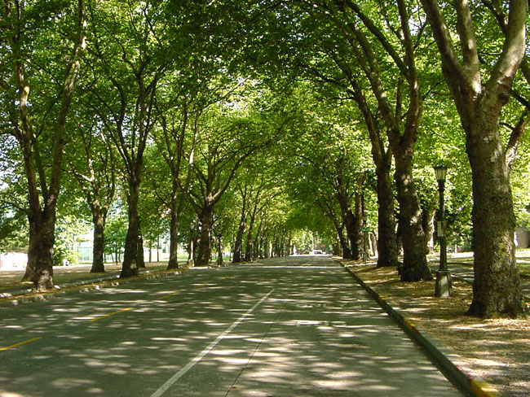
Tree Diagrams
A tree diagram is a way of representing the probabilities of two or more events in a diagram.
To calculate probabilities using a tree diagram, you multiply along the branches

Slide 7

Using tree diagrams
I flip two coins, what is the probability that I get two heads?
P(HH) = $\frac{1}{4}$
Coin 1
Coin 2
1
2
Heads
1
2
1
2
P(HH) = x =
1
4
1
2
Heads
1
2
1
2
P(HT) = x =
1
2
1
4
Tails
1
2
Heads
1
2
1
2
P(TH) = x =
1
4
1
2
Tails
1
2
1
2
P(TT) = x =
1
2
1
4
Probabilities on each branch add up to 1
Tails
Possible outcomes are shown on the end of the branches
Multiply along the branches to work out the probabilities

Slide 8
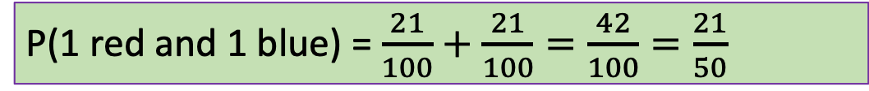
Using tree diagrams
I have a bag of counters, 3 blue and 7 red. I pick one counter out without looking and put it back in the bag, I then pick out another counter. What is the probability that I pick out a red counter and a blue counter?
P(1 red and 1 blue) = $\frac{21}{100}+\frac{21}{100}=\frac{42}{100}=\frac{21}{50}$
Sweet 1
Sweet 2
7
10
7
10
7
10
P(RR) = x =
Red
49
100
7
10
Red
7
10
3
10
P(RB) = x =
3
10
21
100
Blue
7
10
Red
3
10
7
10
P(BR) = x =
21
100
3
10
Blue
3
10
3
10
P(BB) = x =
9
100
3
10
Blue
Notes:
Plenary

Slide 9
Notation
When working with probability, we can use notation that can help us describe the probability of an event occurring.
P(A) = Probability of Event A
P(A’) = Probability Not A

Slide 10

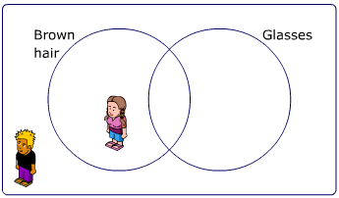
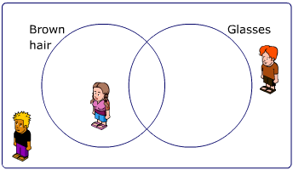
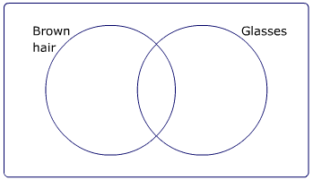
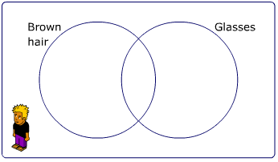
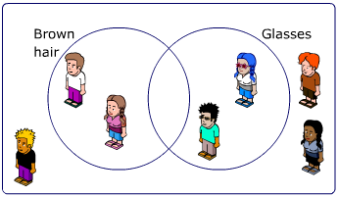
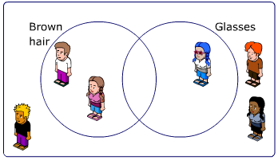
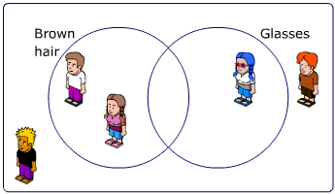
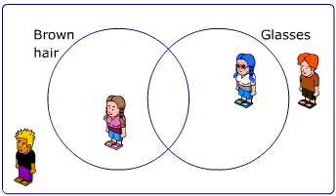
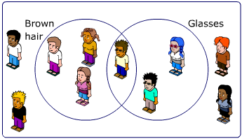
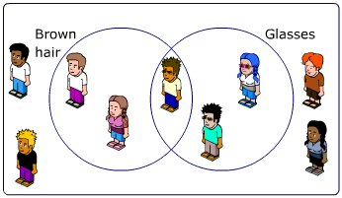
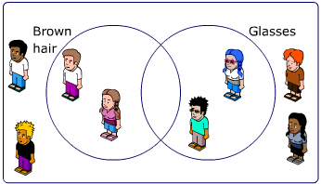
Venn Diagrams
A Venn diagram is used to sort data.
For example, these students below we are going to sort into hair colour and if they wear glasses.

Slide 11
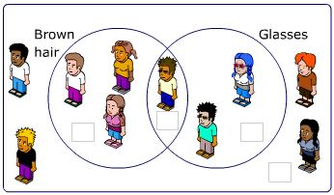
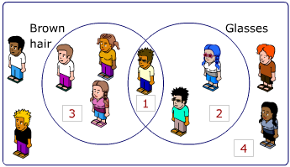
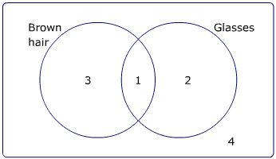
Venn Diagrams
This is the universal set symbol.
It represents all the data.
Rather than drawing pictures, we tend to write numbers to represent each event. So,
$$ξ$$
becomes
becomes
Notice how we have to include how many are NOT in either of the circles.

Slide 12
Using a Venn Diagram
We can use a Venn diagram to calculate a probability.
How many children are there altogether?
$\frac{4}{10}$ = $\frac{2}{5}$
P(brown hair) =
3 + 1 + 2 + 4 = 10
$$\frac{3}{10}$$
How many children have brown hair?
P(wears glasses) =
3 + 1 = 4
= $\frac{1}{10}$
How many children wear glasses?
P(brown hair and wears glasses)
1 + 2 = 3
How many children have brown hair and wear glasses?
P(not brown hair and doesn’t wear glasses) =
$\frac{4}{10}$ = $\frac{2}{5}$
1
How many children don’t have brown hair and don’t wear glasses?
4

Slide 13


Example
A card is selected at random from a pack of 52 playing cards. Let A be the event that the card is and ace and D the event that the card is a diamond. Find:
a) P(A and D)
b) P(A or D)
c) P(A’)
d) P(A’ and D)
There are 13 diamonds of which 1 is an Ace
There are 4 aces of which 1 is a diamond
There are 52 playing cards, 52 – (3 + 1 + 12) = 36 left
$$ξ$$
A
D
3
1
12
36

Slide 14
Example
A card is selected at random from a pack of 52 playing cards. Let A be the event that the card is and ace and D the event that the card is a diamond. Find:
a) P(A and D)
b) P(A or D)
c) P(A’)
d) P(A’ and D)
$$\frac{1}{52}$$
This is the middle of the Venn diagram:
This is the either an ace or a diamond, not forgetting both:
$$\frac{3+1+12}{52}$$
= $\frac{16}{52}$
$$ξ$$
A
D
3
1
12
36

Slide 15
Example
A card is selected at random from a pack of 52 playing cards. Let A be the event that the card is and ace and D the event that the card is a diamond. Find:
a) P(A and D)
b) P(A or D)
c) P(A’)
d) P(A’ and D)
$$\frac{12+36}{52}$$
= $\frac{48}{52}$
This is the everything that does not involve A:
= $\frac{12}{52}$
This is not an ace but is a diamond (can’t include the middle):
$$ξ$$
A
D
3
1
12
36

